Slide 1
Laying Out Pages and Screens
Chapter Nine

Slide 2
Introduction
Document layout has two main elements:
  The design screen and pages:
    Their density, balance, look-ability, and legibility (readability).
    Determining the best arrangement of words and images on a page or screen to achieve maximum usability.
  The design of the type:
    The size, font, and style of the letters used to make words, and designing format for tables, lists and paragraphs.

Slide 3
Guidelines for Designing Pages and Screens
Review the user analysis.
Create page grids.
Draw thumbnail sketches.
Set up pages and styles in your word processor.
Determine the layout of help document.

Slide 4
Guidelines
1- Review the user analysis:
based on your user analysis , what you thought your pages would look like .
The goals of page and screen layout, they resembles those of document design:
  Allow the user to overcome the design problem, the layout should meet dynamic need with static layout.
  Support overall task orientation.
  Accommodate the visual needs of the user, the need to learn and do through images rather than words.

Slide 5
Guidelines
2- Create Page Grid :
Page grid define communication spaces by drawing invisible fences among the areas of a page.
To design a page you need to know:
- Grid lines, lines drawn where page and column margin
would fall.
- Margins, spaces between text and page edge.
- Columns, spaces between the gridlines marking columns.
- Gutters, space between columns.
- white spaces.
page grid provide the road map for almost all your pages.

Slide 6
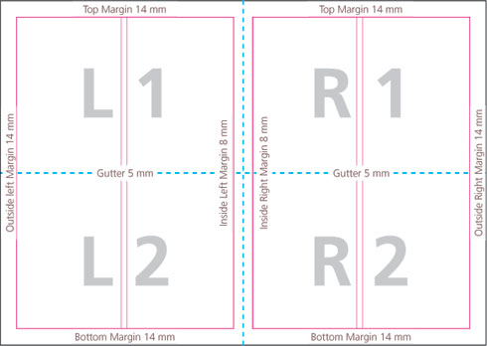
Page Grid

Slide 7
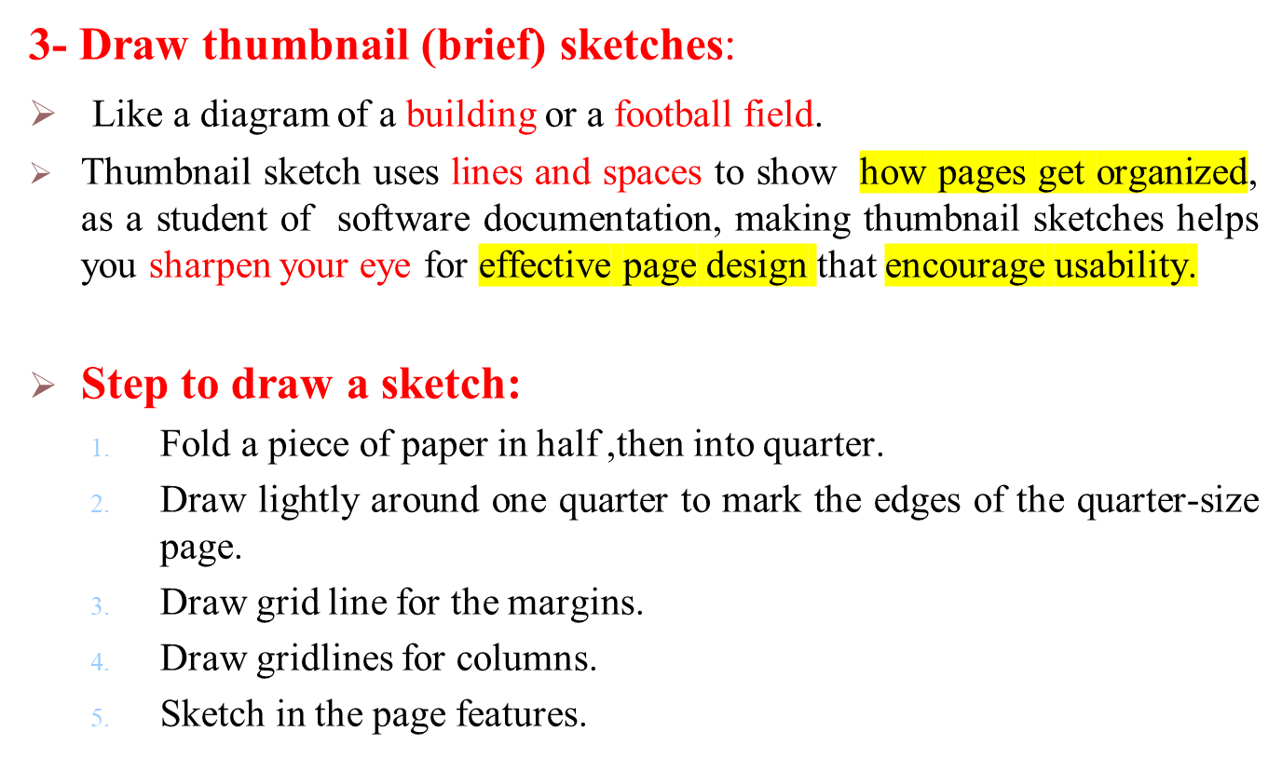
Guidelines

Slide 8
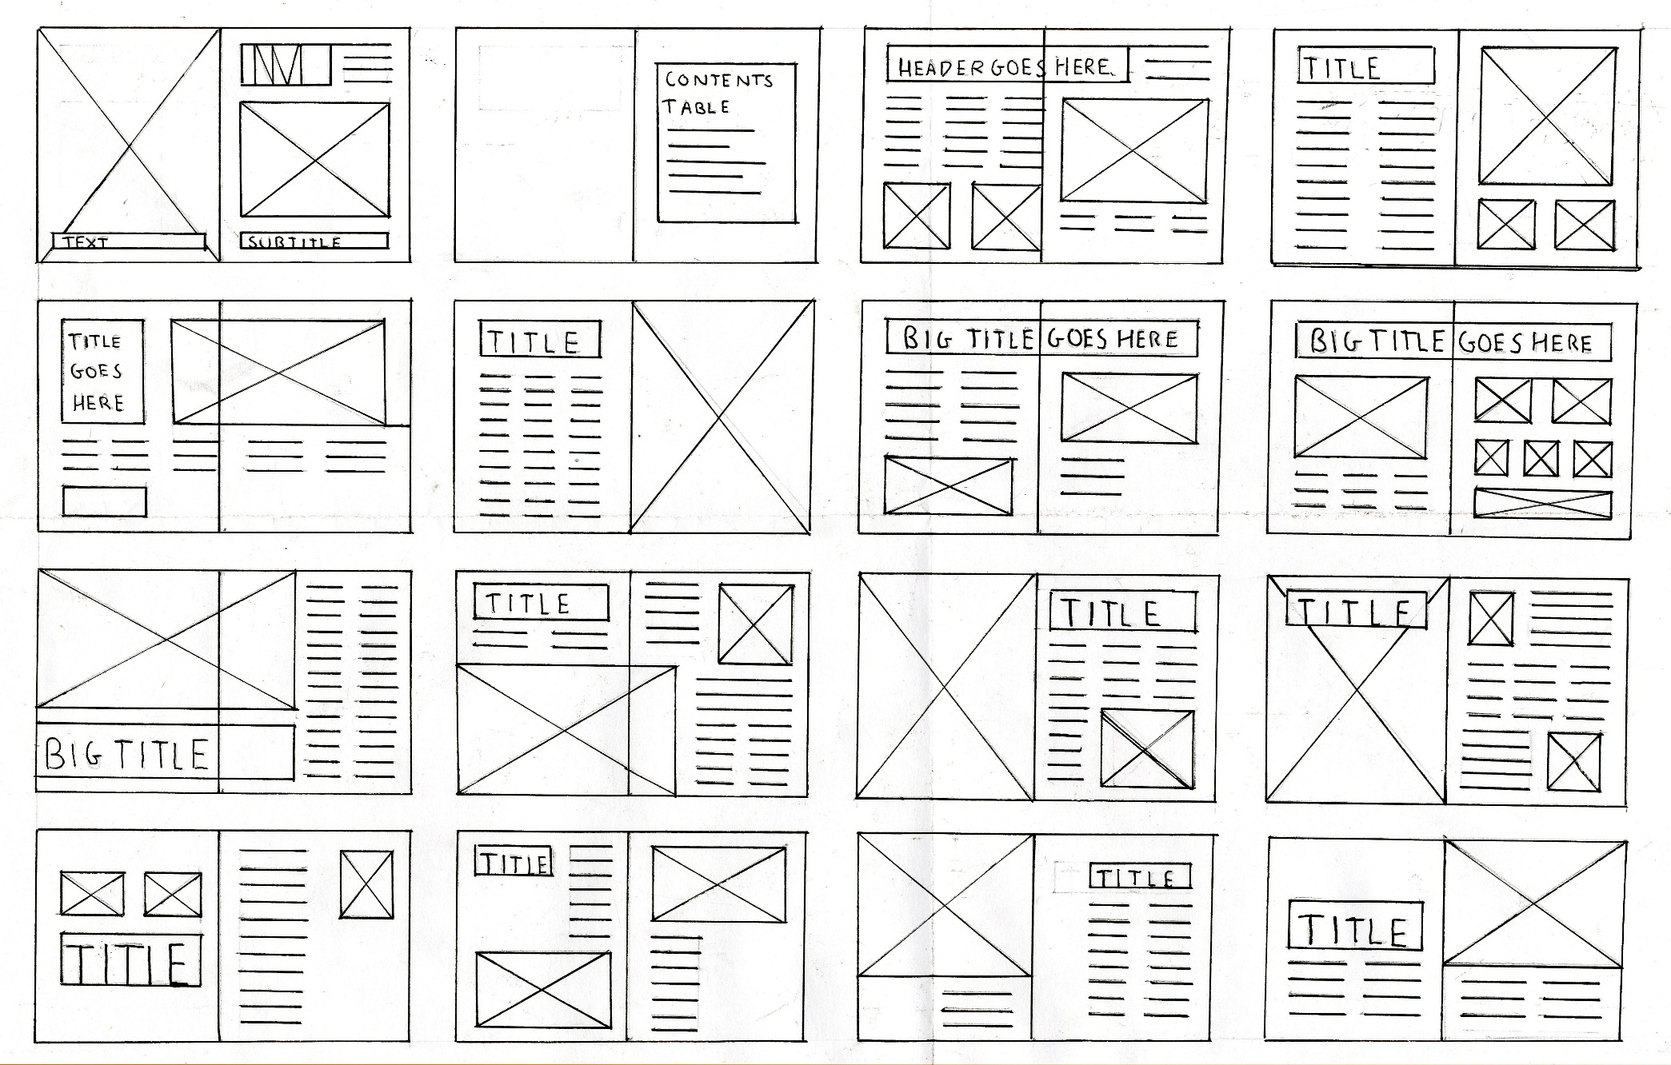
Draw Thumbnail

Slide 9
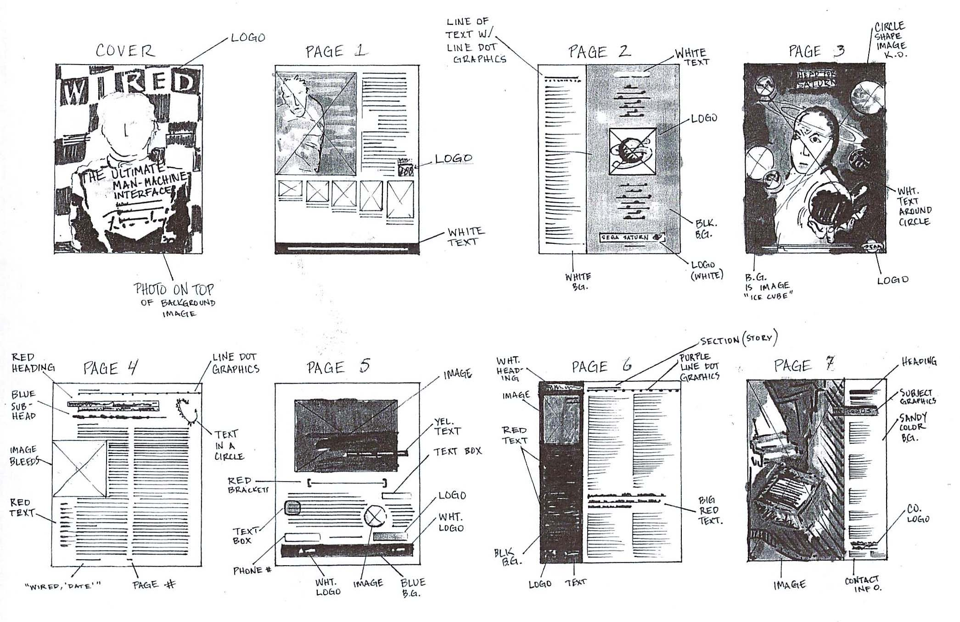
Draw Thumbnail

Slide 10
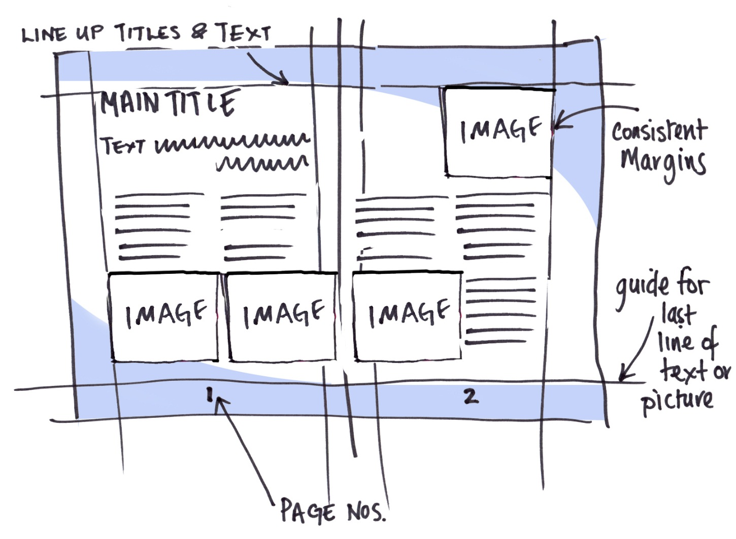
Draw Thumbnail

Slide 11
Guidelines
4- Define styles for pages and screens components :
Your style for page and screen components should include
margins top and bottom left and right, gutters, icons, tabs,
page number, heading.

Slide 12
Guidelines
5- Set Up pages and styles in Your word processor:
This will save you time in the long run.
You can change the style later, you do not have to change
each instance of a certain text.
Insures consistency

Slide 13
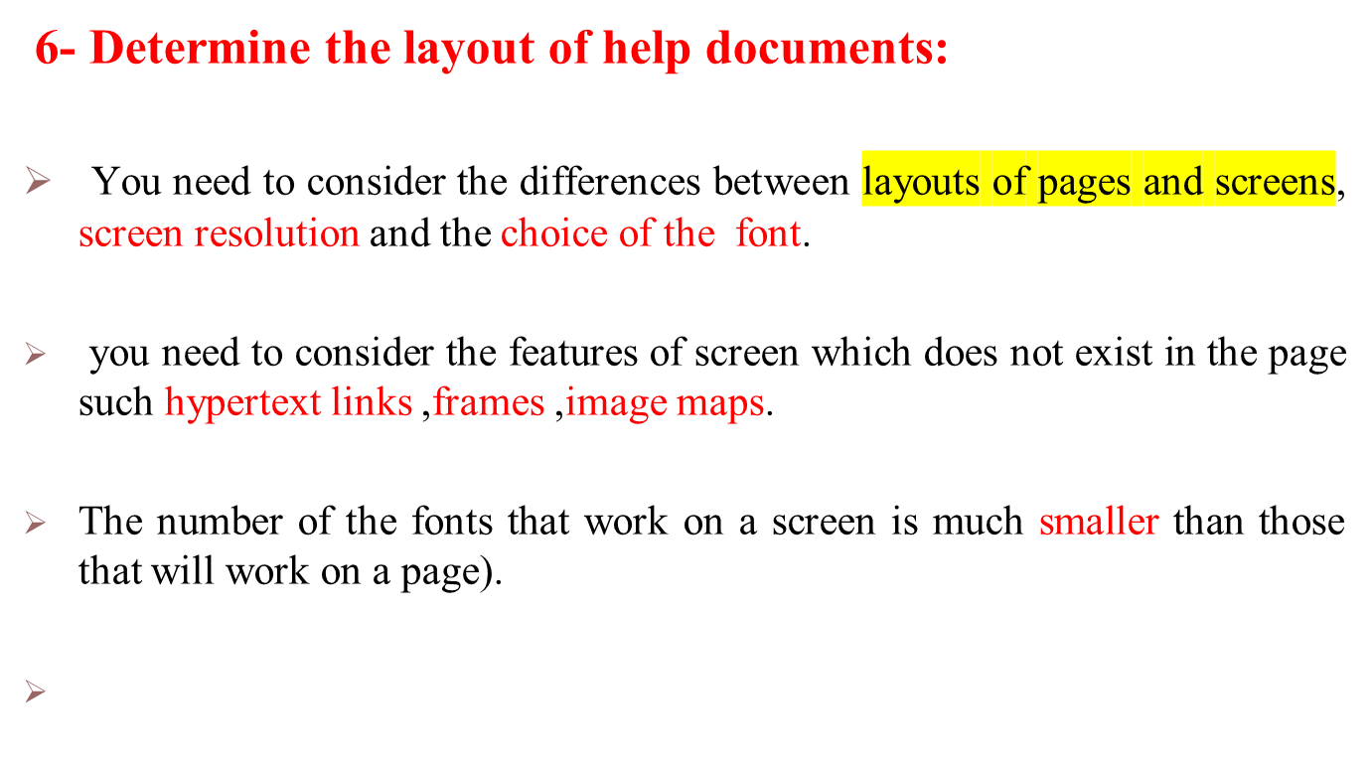
Guidelines

